Slide 1

Red Hat System Administration I 10.0
Chapter 4
Dilara Gülenç

Slide 2
Registering Systems for Red Hat Support
Red Hat CDN Access: Delivers regular updates, security patches, bug fixes, and software enhancements.
Support Resources: Active subscriptions include Customer Portal Labs, Knowledgebase, documentation, Red Hat Insights, and expert technical support.
Simple Content Access (SCA): Validates subscriptions at the organization level, removing the need to manually attach subscriptions per system.
Hybrid Cloud Console (console.redhat.com): Serves as the central interface for inventory and subscription management.

Slide 3
Registering Systems for Red Hat Support
Identity Certificates: Issues unique identity certificates to authenticate the system to Red Hat subscription services.
Repository Enablement: Automatically enables default repositories for installed products with the ability to add optional repositories.
Inventory Tracking: Tracks entitlements directly on the Subscription Inventory page in the Hybrid Cloud Console.
Insights Connectivity: Connects systems to Red Hat Insights for predictive analytics and automated issue resolution.

Slide 4
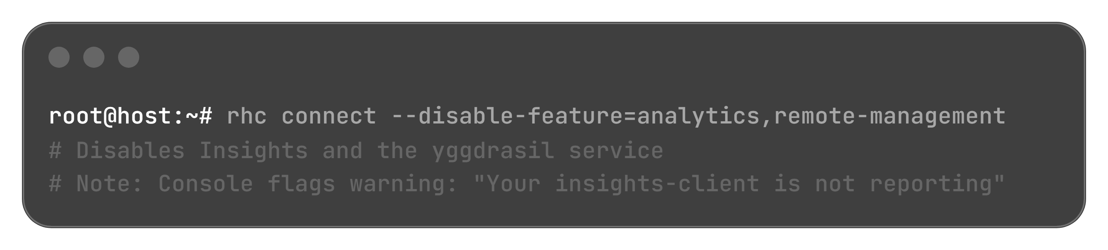
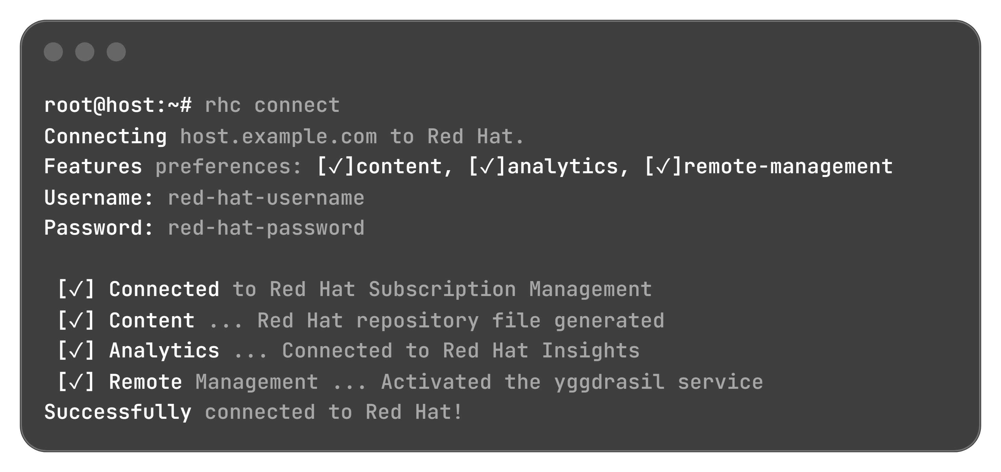
Modern System Registration: The rhc Tool
rhc Tool Overview (RHEL 8.8+):
Integrates three services in a single workflow: content, analytics, and remote-management.
Requires a valid Red Hat account and root privileges on the managed system.
1. Default Connection (All Features Enabled):
2. Disabling Optional Features (--disable-feature):
Exclude Insights and remote management to permit repository access only:

Slide 5
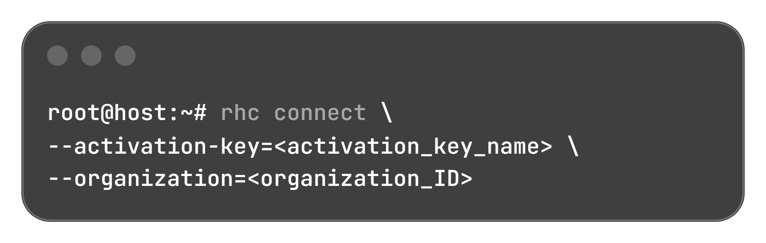
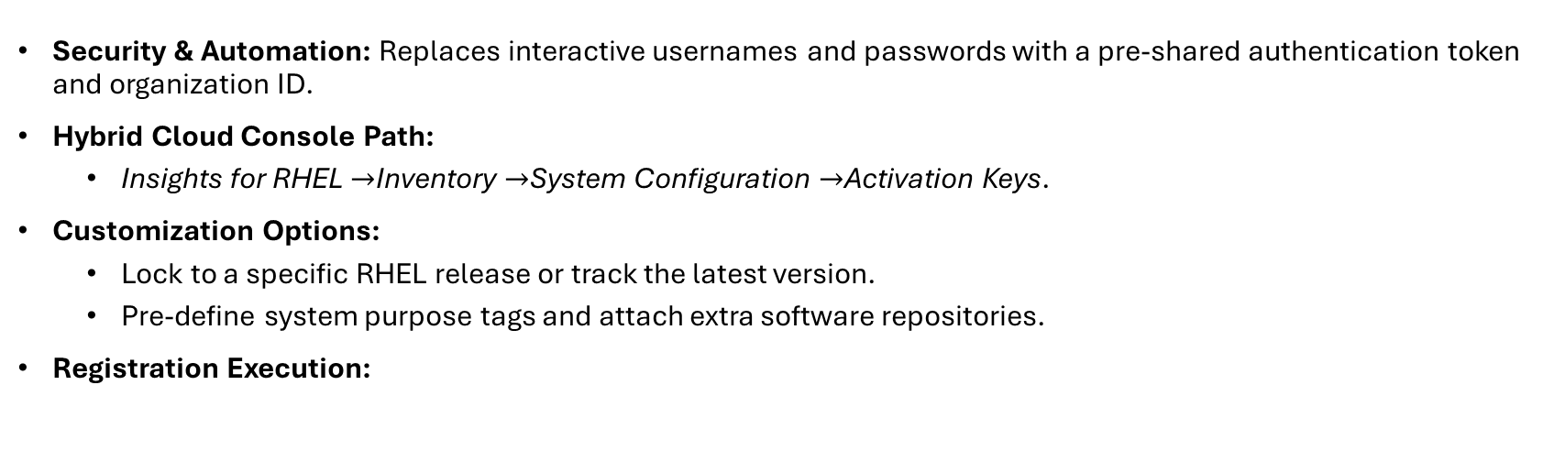
Automation via Activation Keys & rhc Disconnection
Security & Automation: Replaces interactive usernames and passwords with a pre-shared authentication token and organization ID.
Hybrid Cloud Console Path:
  Insights for RHEL $→$Inventory $→$System Configuration $→$Activation Keys.
Customization Options:
  Lock to a specific RHEL release or track the latest version.
  Pre-define system purpose tags and attach extra software repositories.
Registration Execution:

Slide 6
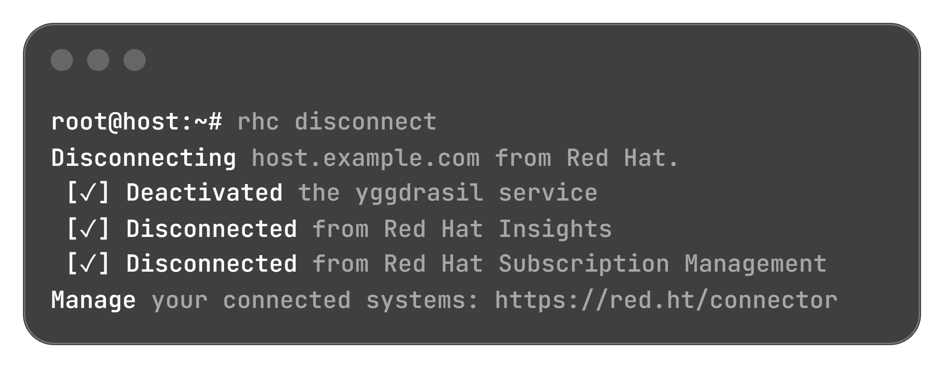
Automation via Activation Keys & rhc Disconnection
Single Command Teardown:
Stops the yggdrasil service.
Disconnects the host from Red Hat Insights.
Removes the host from Red Hat Subscription Management.

Slide 7
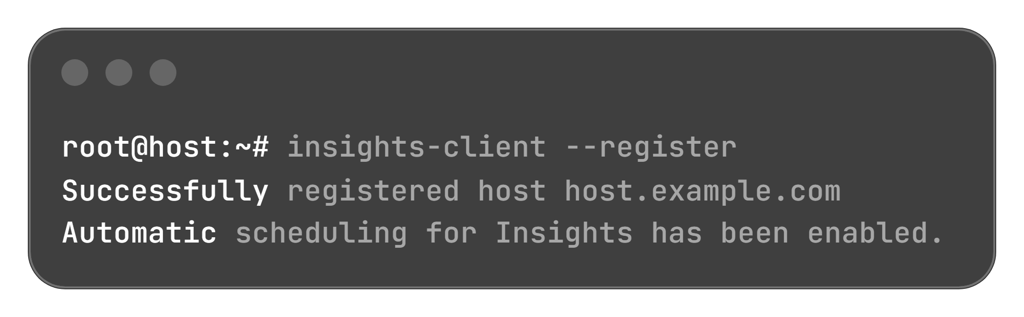
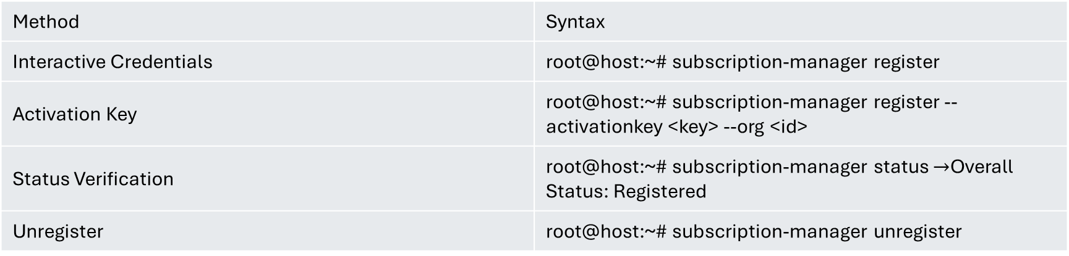
Legacy Registration with subscription-manager
Tool Characteristics:
Usable on all RHEL versions (required for RHEL 8.7 and earlier; fully functional in RHEL 10).
Modules for per-system subscription attachment have been removed under SCA.
Does not auto-register systems with Red Hat Insights.
Method | Syntax
Interactive Credentials | root@host:~# subscription-manager register
Activation Key | root@host:~# subscription-manager register --activationkey <key> --org <id>
Status Verification | root@host:~# subscription-manager status $→$Overall Status: Registered
Unregister | root@host:~# subscription-manager unregister
Manual Insights Enablement (insights-client):

Slide 8
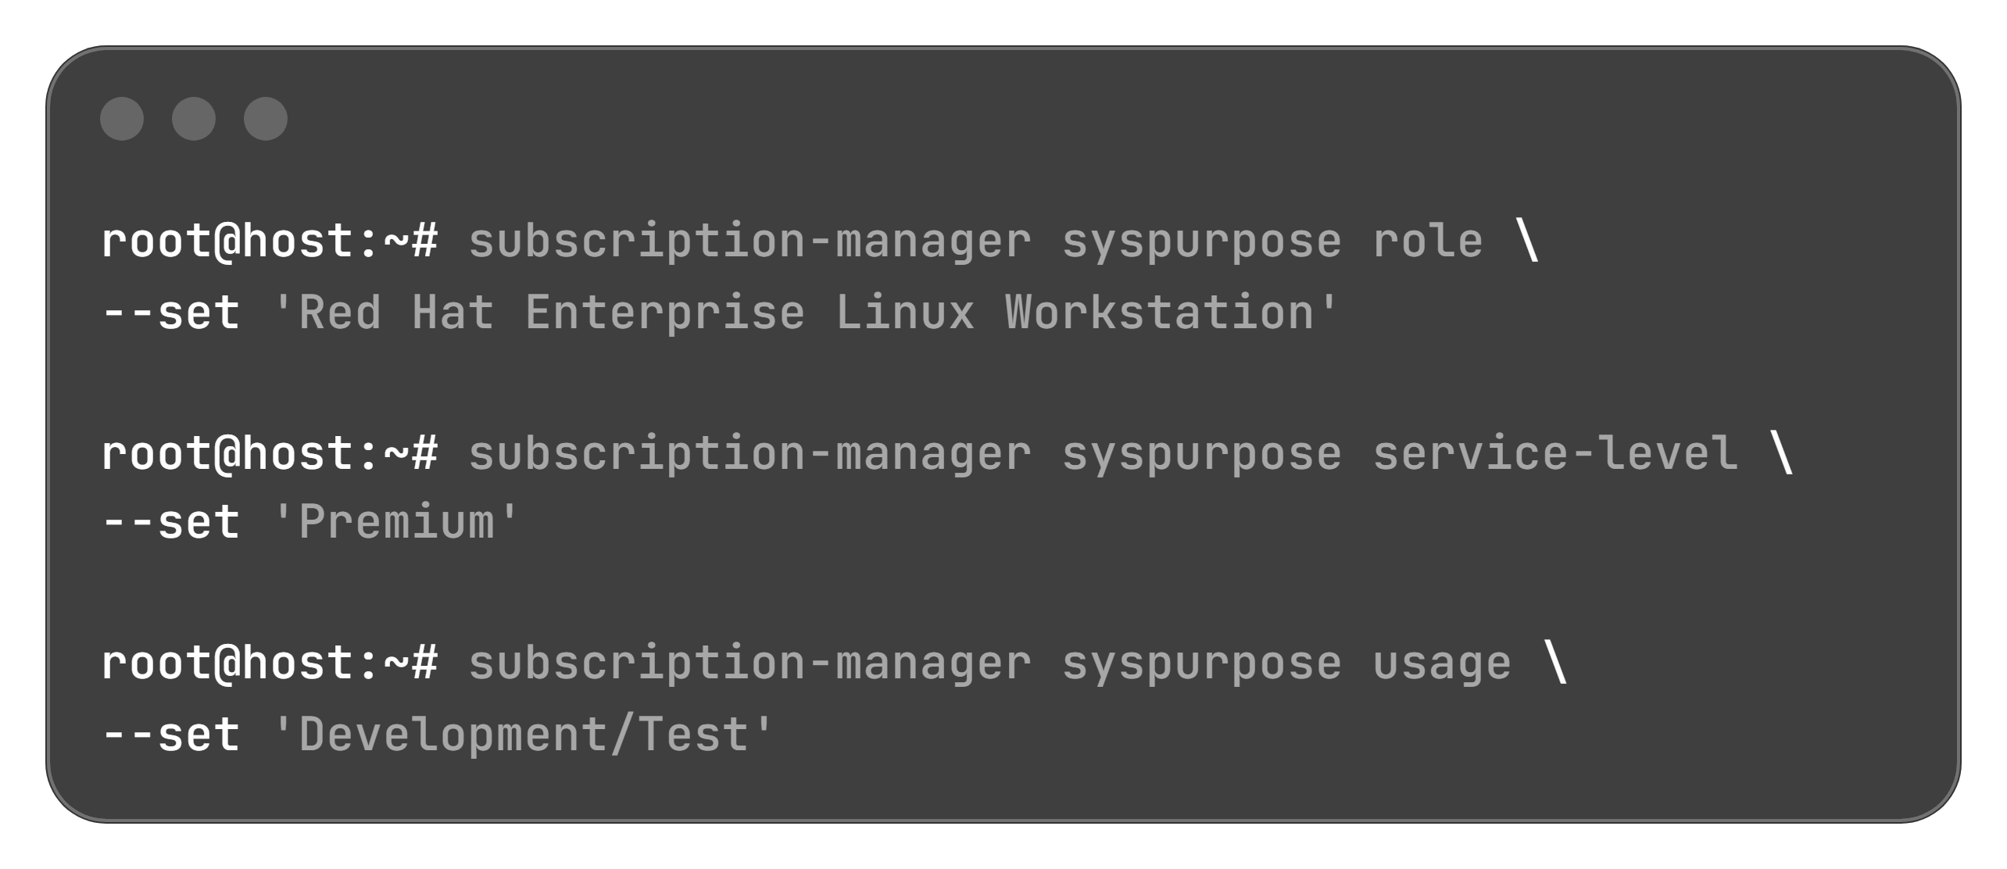
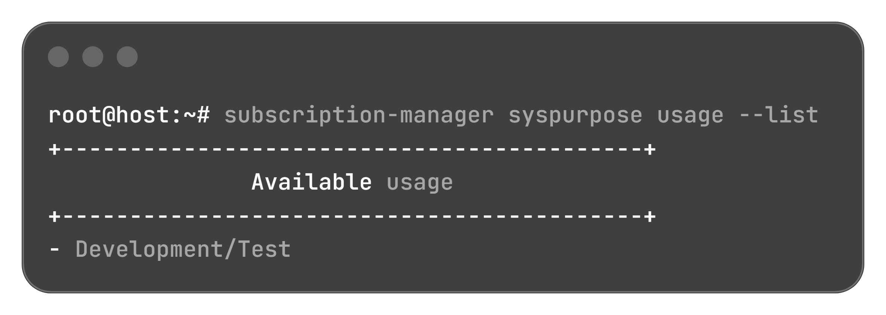
Setting System Purpose Attributes
Role:
Red Hat Enterprise Linux Server
Red Hat Enterprise Linux Workstation
Red Hat Enterprise Linux Compute Node
Service-Level Agreement (SLA):
Premium
Standard
Self-Support
Usage:
Production
Development/Test
Disaster Recovery
Setting Attributes:
Listing Valid Values (--list):

Slide 9
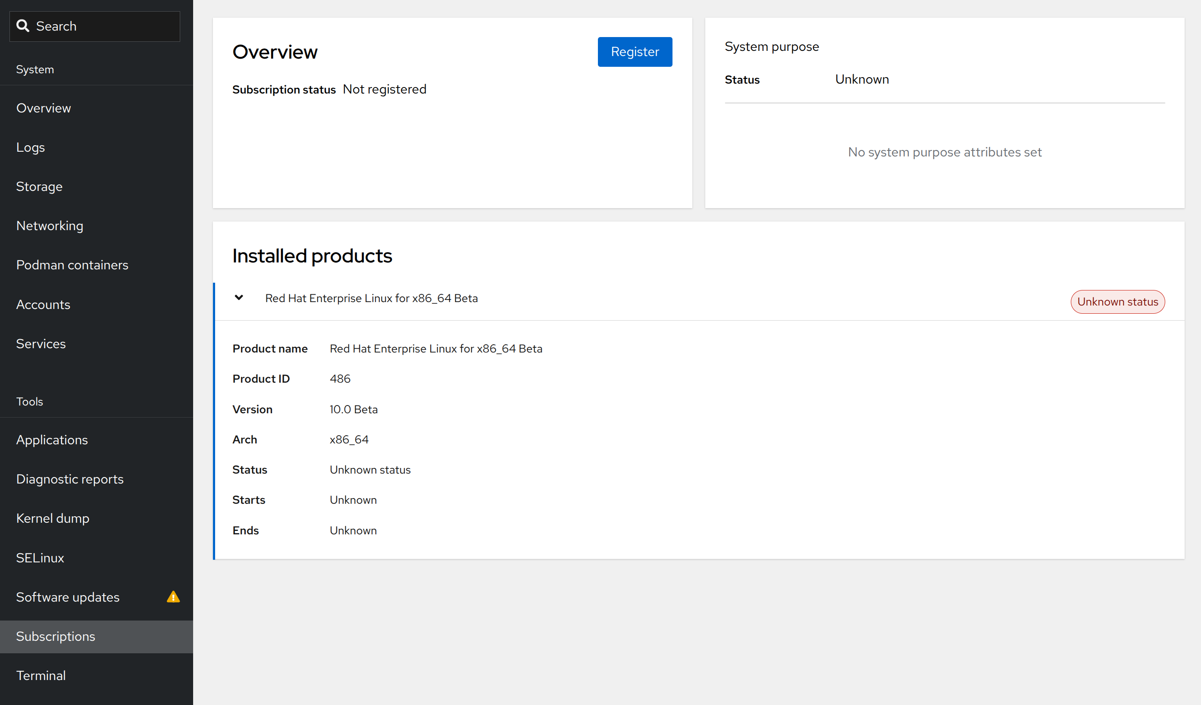
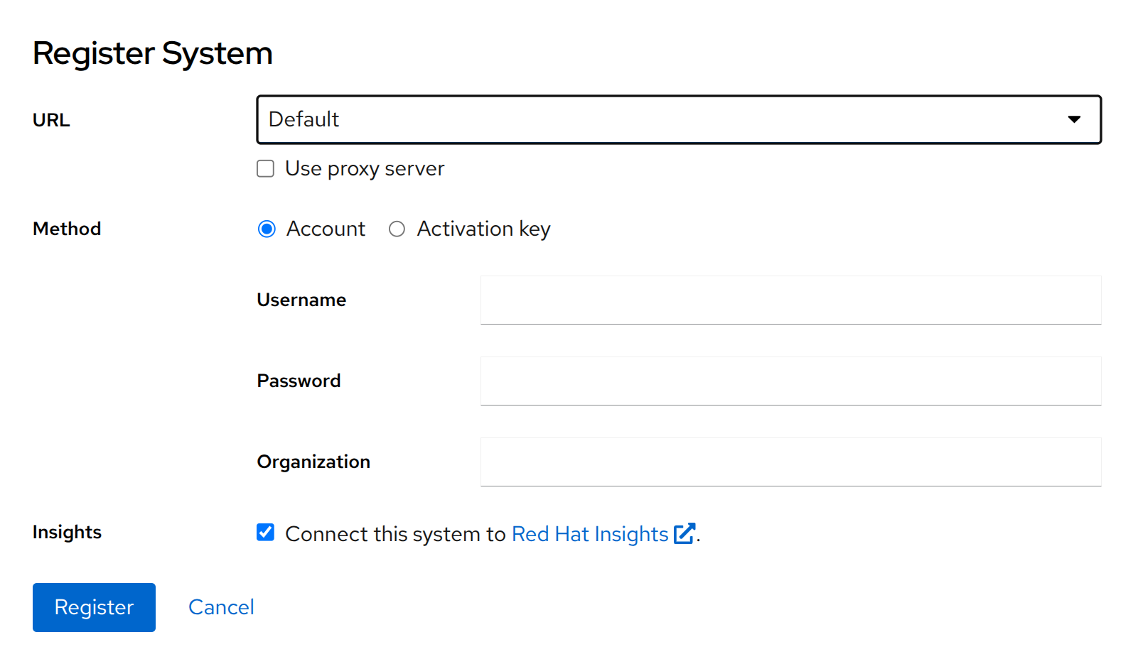
Graphical Registration via RHEL Web Console
Access Requirement: Log in to the RHEL web console as a privileged user.
Navigation: Click Subscriptions in the side menu to view subscription status and installed products.
Initiation: Click Register in the Overview pane to launch the modal dialog.
Authentication Choices:
  Account: Red Hat username and password.
  Activation Key: Pre-shared token combined with an Organization ID.
Insights Default: The option Connect this system to Red Hat Insights is preselected by default.

Slide 10
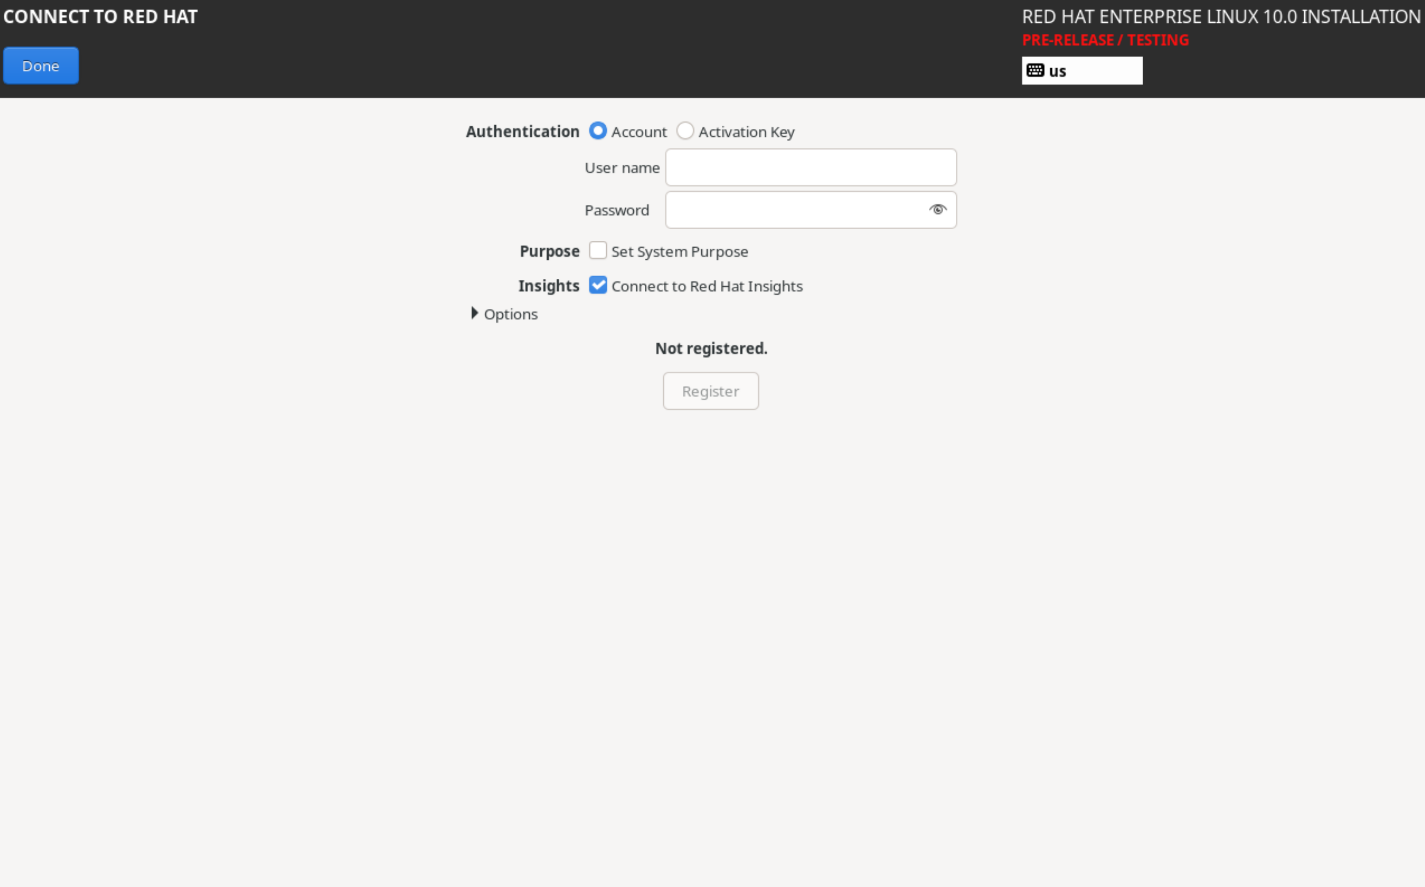
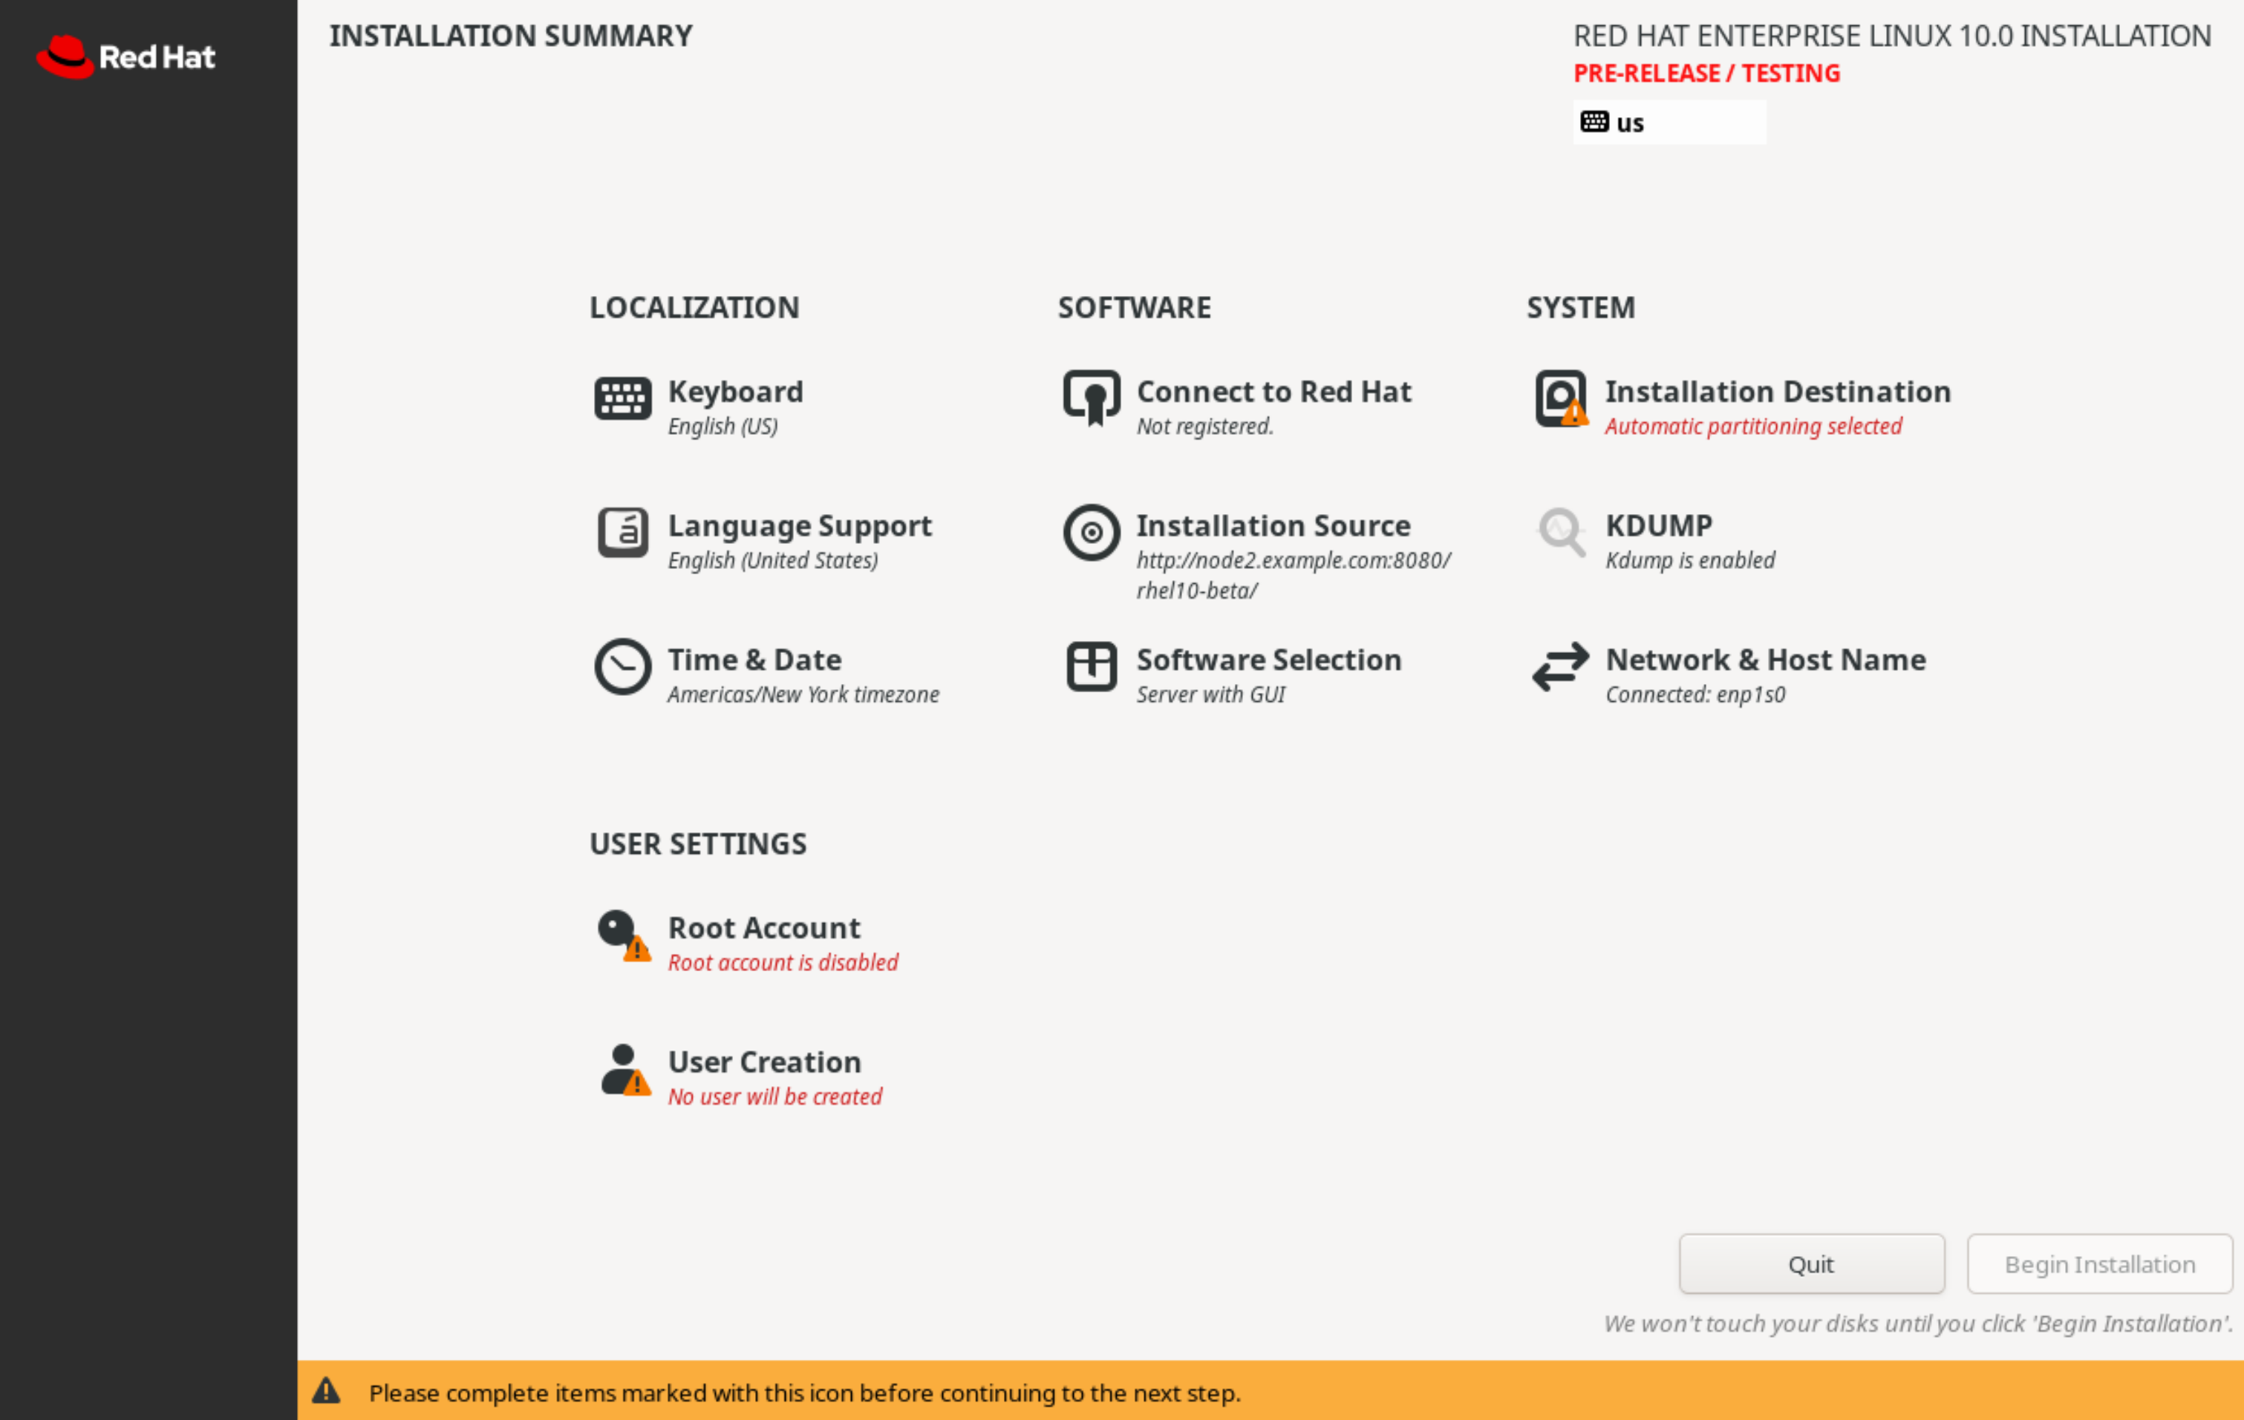
Target Registration During Installation
Interactive Installation (Anaconda):
  Target bare-metal or virtual instances register before package installation begins.
  From the Installation Summary screen, select Connect to Red Hat.
  Authenticate via Account credentials or an Activation Key.
  Optionally configure System Purpose tags and enable Red Hat Insights.
Automated Installation (Kickstart):
  Use the rhsm Kickstart command in configuration files.
  Requirement: Must supply an activation key and organization identifier.

Slide 11
System Identity Certificates & Inspection
Certificate Path | Certificate & Key Purpose
/etc/pki/product-default/ | Identifies the specific Red Hat products installed on the system
/etc/pki/consumer/ | Certificate and key pair identifying the registered system instance
/etc/pki/entitlement/ | Certificate and key pair authenticating the system to content repositories

Slide 12
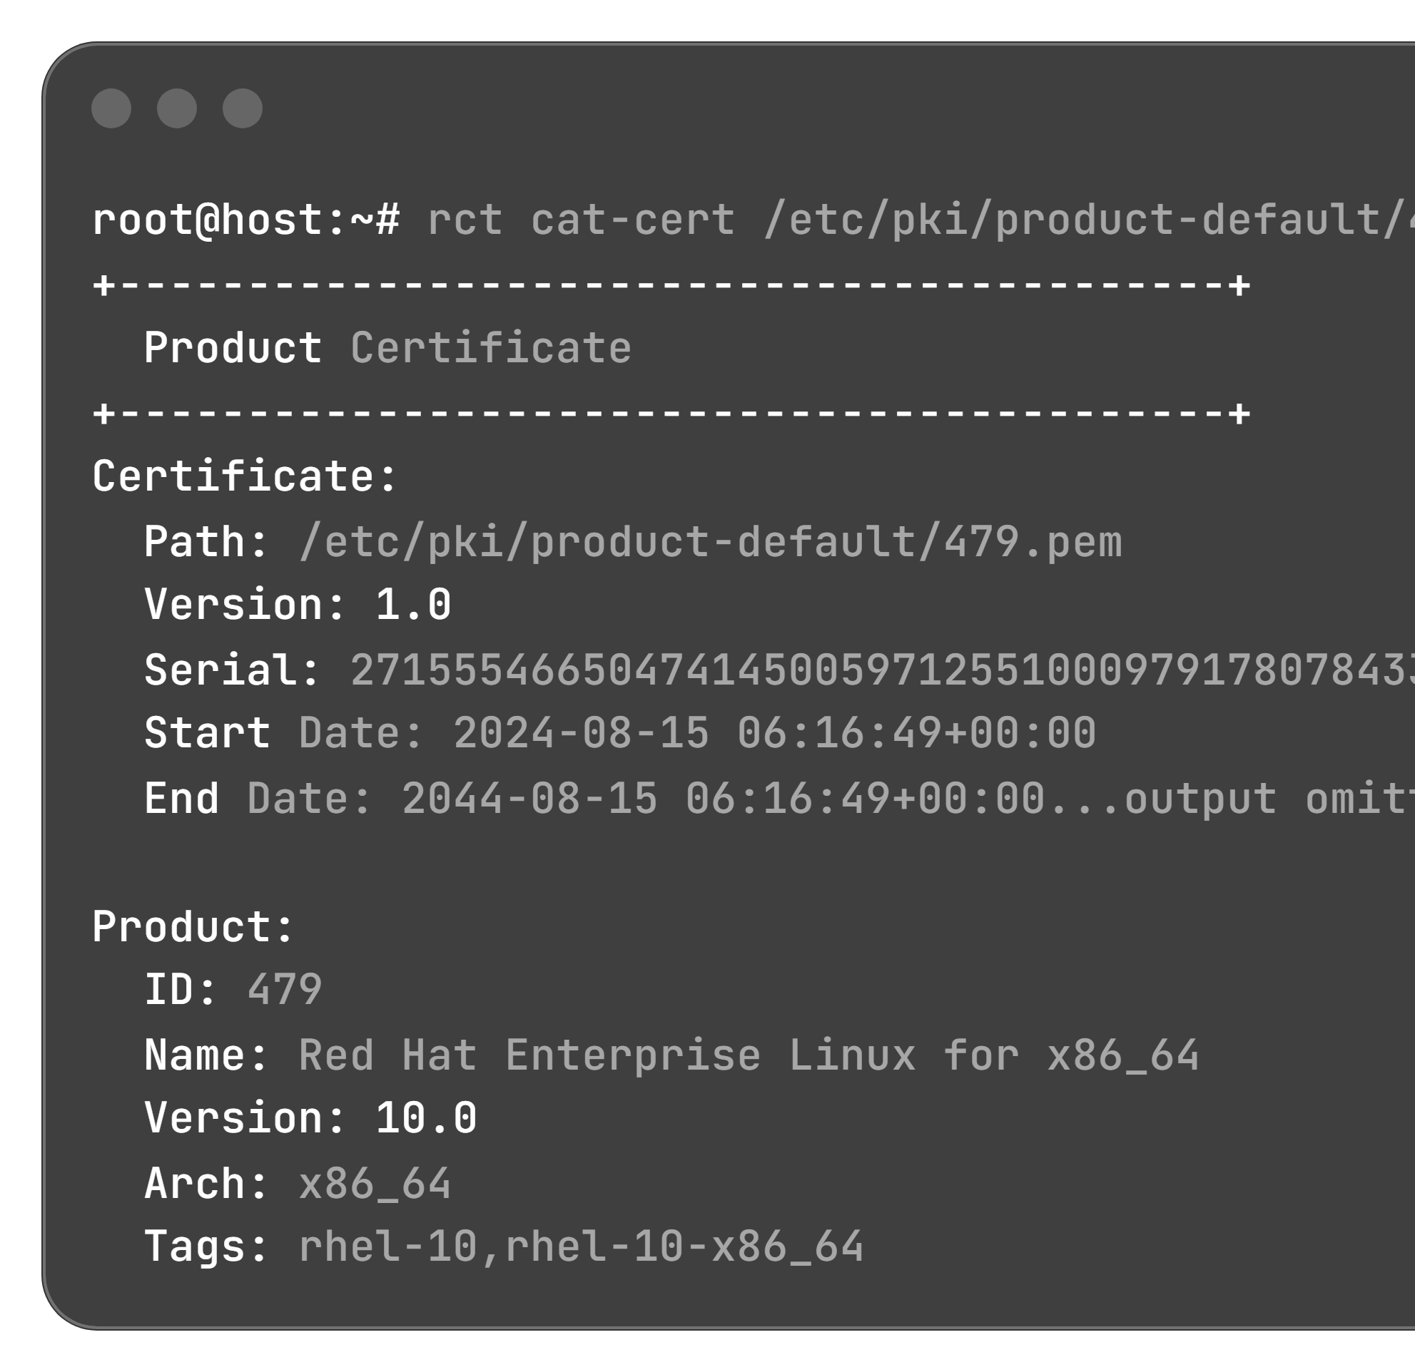
System Identity Certificates & Inspection
Inspecting Product Certificates (rct cat-cert):
Use rct cat-cert to read metadata (version, serial, validity dates, architecture, product name, and release tags):

